Slide 1

STEPS ON HOW TO REGISTER IN AEW REGISTRY SYSTEM

Slide 2
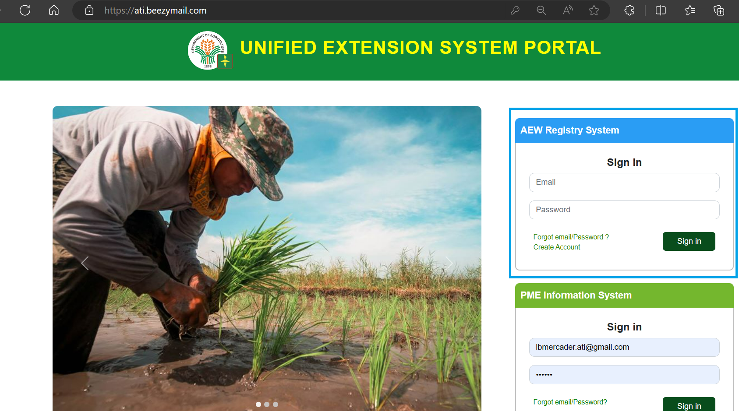
Step 1:
Click
“Create Account”

Slide 3
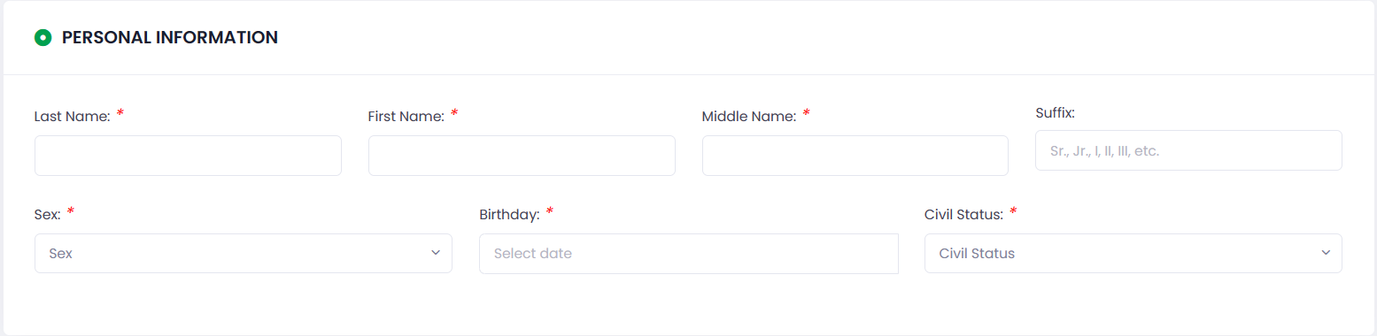
Step 2: Fill-up Personal Information

Slide 4
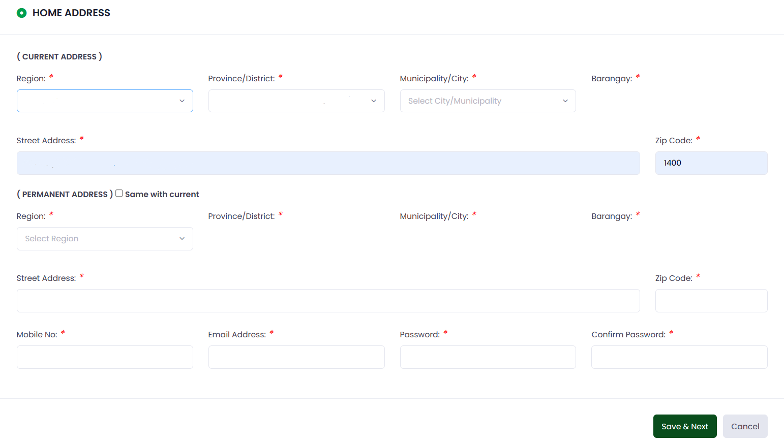
Step 3: Fill-up Home and Current Address

Slide 5
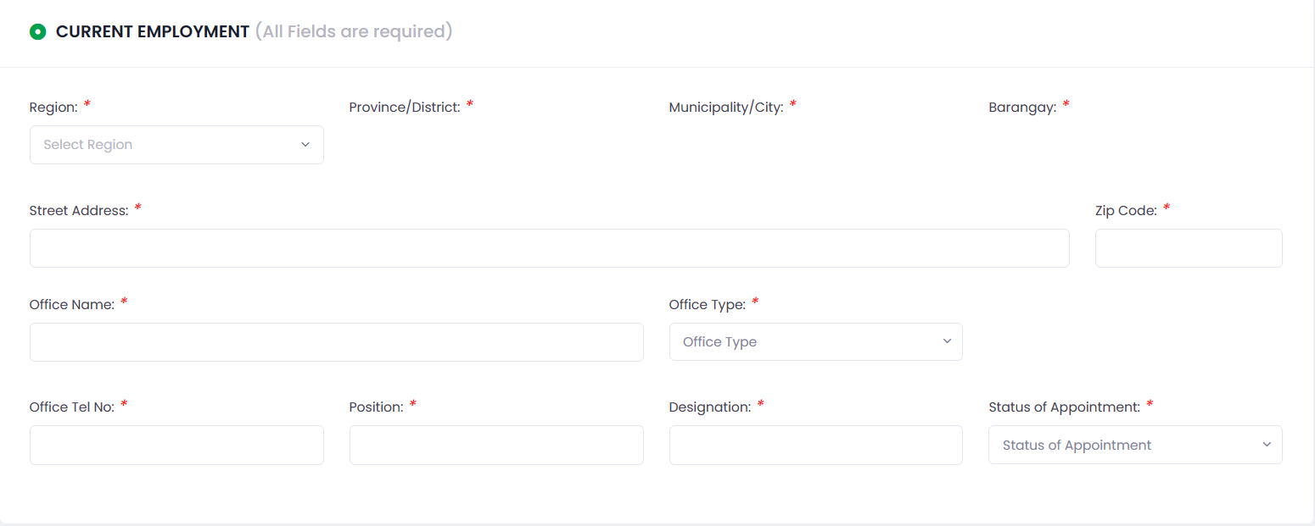
Step 4: Fill-up Current Employment

Slide 6
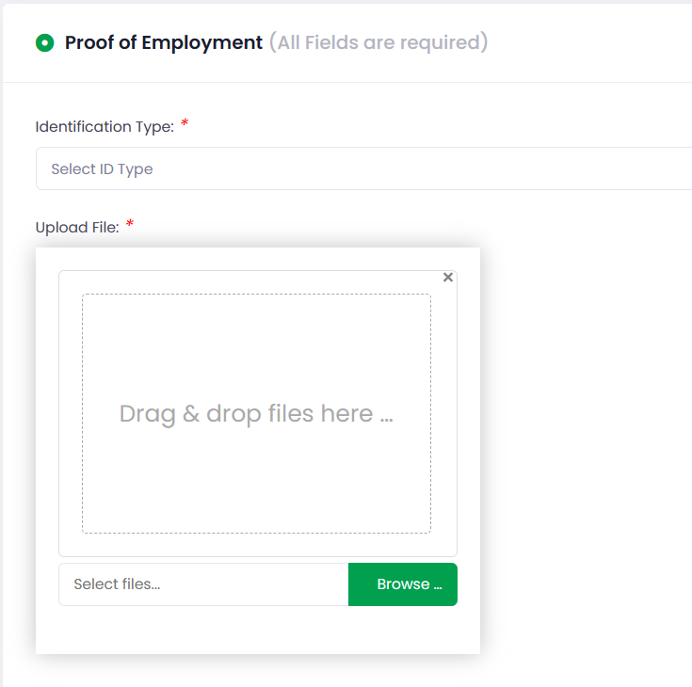
Step 5: Upload Documents for your Proof of Employment

Slide 7
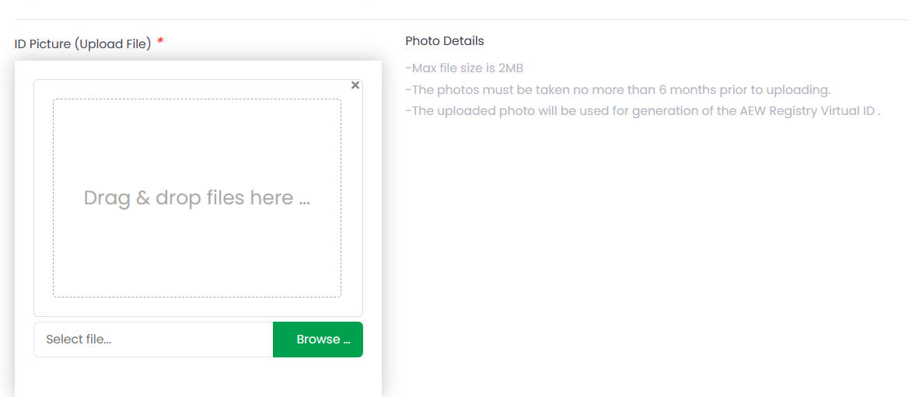
Step 5: Upload Documents for your Proof of Employment

Slide 8
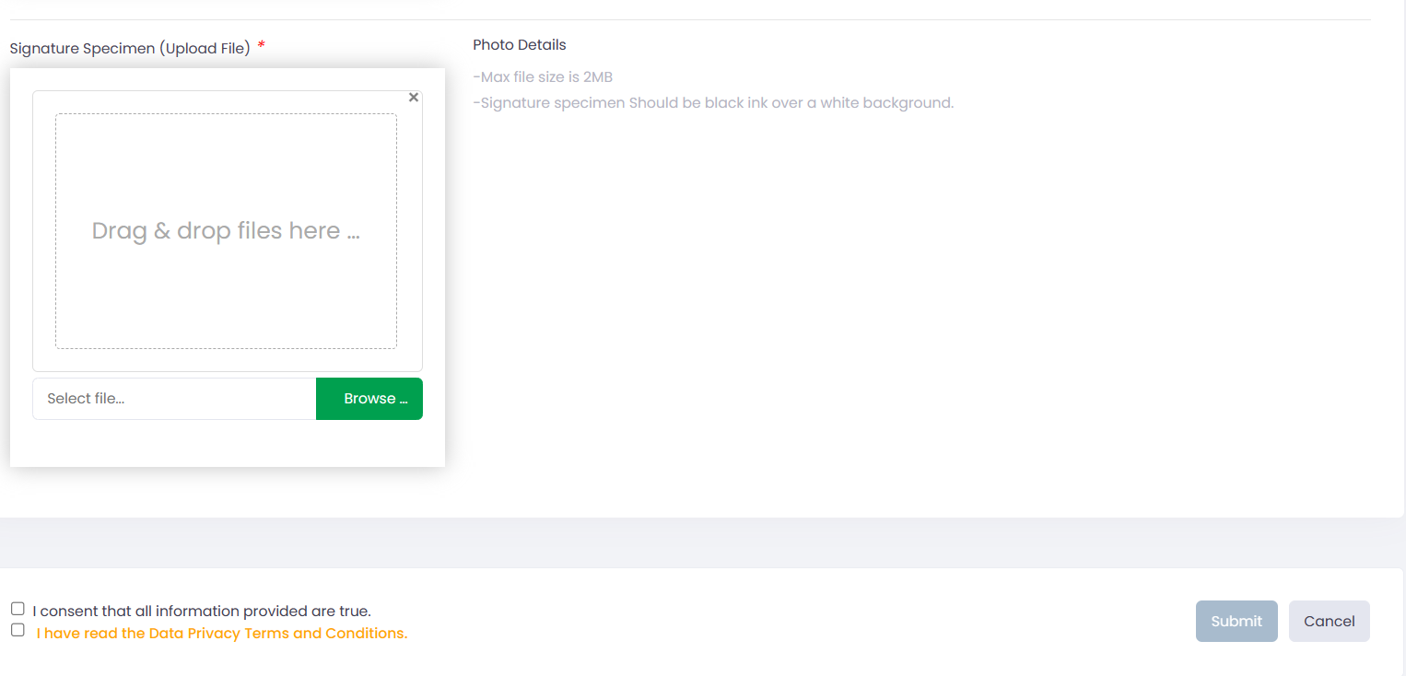
Step 5: Upload Documents for your Proof of Employment

Slide 9
Step 6: Tick Boxes and Submit your Registration

Slide 10
Thank you!

